Slide 1

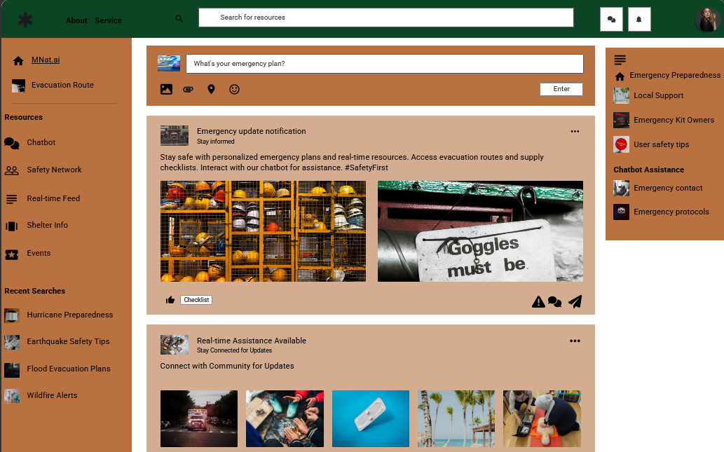
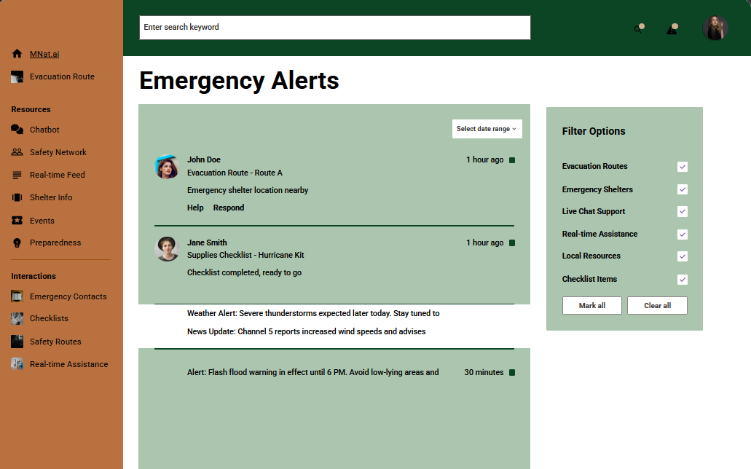
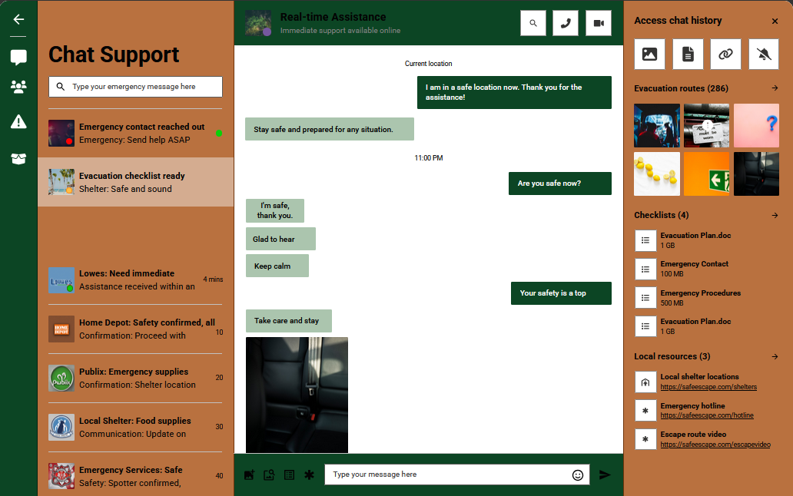
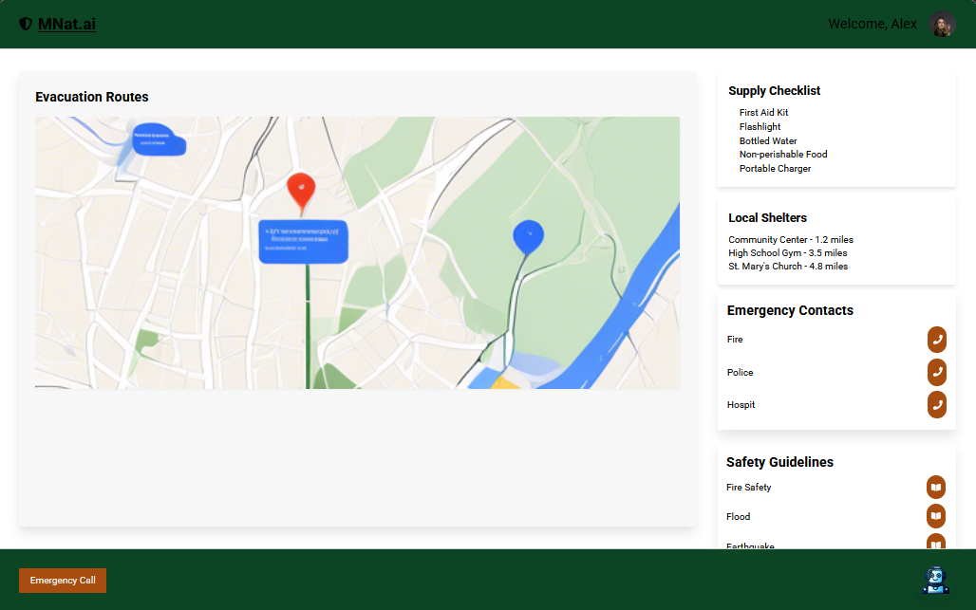
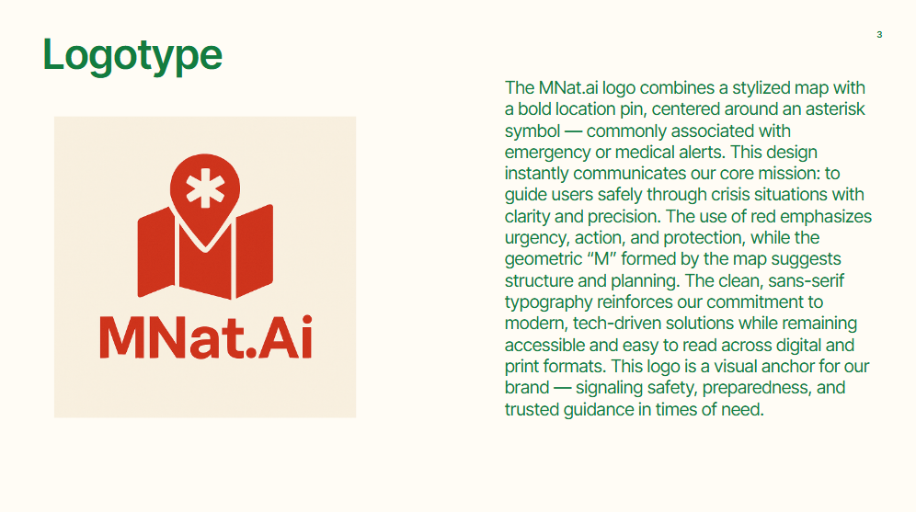
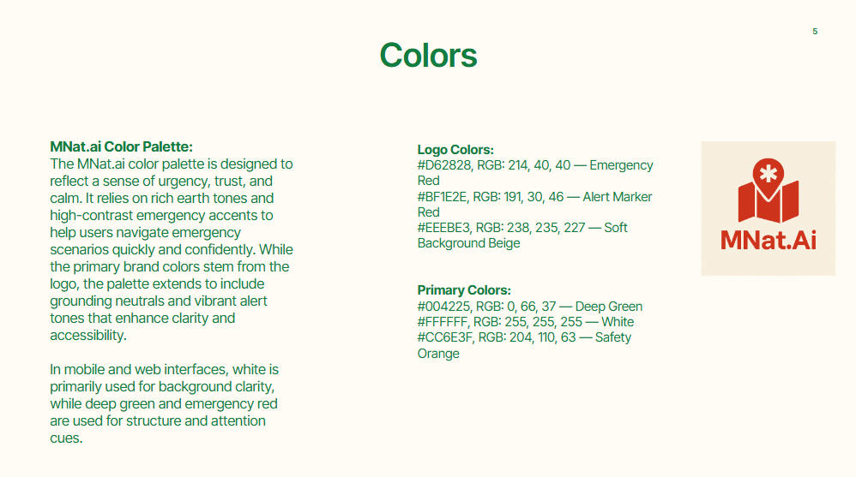
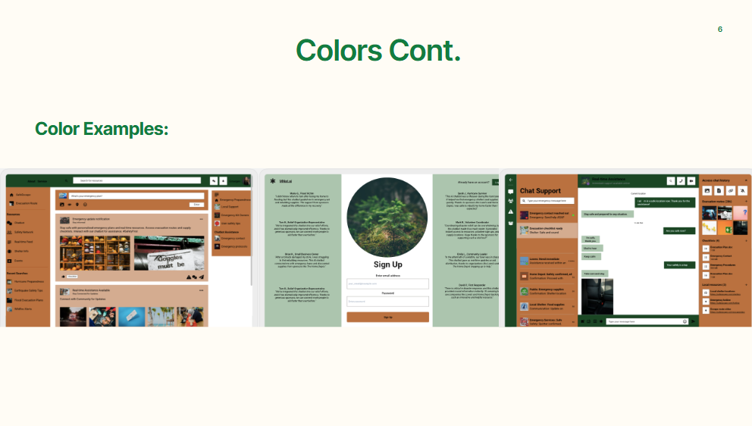
MNat.ai
Introduction
Wireframes
Process
MNat.ai is an advanced natural disaster relief AI tool designed to support individuals in high-risk areas with personalized emergency planning and real-time resources. Powered by OpenAI’s ChatGPT-4 and integrated with accurate weather data and GIS mapping, the platform provides users with custom evacuation routes, supply checklists, local shelter information, and live updates. Users can interact with a weather-trained chatbot to get real-time answers to disaster-related questions, helping them stay informed and prepared. The platform also includes a built-in store, allowing users to conveniently purchase all necessary emergency equipment in one place—creating a seamless, enclosed ecosystem for disaster readiness. A central dashboard curates news updates from both national and local sources, which users can customize to their preferences. Critical alerts can be pinned in a dedicated Emergency Alerts tab, with the option to have messages read aloud. As natural disasters increase in frequency and severity, MNat.ai meets a growing need for tech-driven, personalized emergency preparedness—offering value through premium subscriptions, affiliate retail partnerships, and enhanced disaster resilience.
When people access our product, they access information that the AI processes according to the data received from meteorology sites that have accurate data forecasts about natural disasters. The data is processed into an alert for factors like disaster type or location. The data then references resources that are needed to combat the disaster in question. The user can be linked to providers of said resources, and our product is financially compensated to fund our product. The AI is helpful in times of danger or leading up to danger to prevent any harm from happening to anyone who wants to use it.
Hardware
Software
GPS Modules / Location Trackers
Enable real-time evacuation routing and nearby shelter detection
Smartphones / Tablets
Primary devices for app access, push notifications, and offline plan storage
Satellite Phones / Emergency Radios
Provide access to exported plans and updates when cell service is down
Portable Printers
Allow users to print personalized escape plans and emergency checklists
Power Banks / Solar Chargers
Ensure continuous device usage during outages and evacuations
Wearable Tech (Smartwatches)
Sync with the app for quick access, haptic alerts, and real-time updates
Our tech stack combines modern tools like React, Firebase, and Google Maps with AI, GIS, and real-time databases to deliver a responsive, intuitive user experience. Features like multilingual support, offline access, push notifications, and personalized alerts enhance quality of life during emergencies. Tools like Docker, Kubernetes, and CI/CD pipelines ensure reliability and fast updates under pressure.
APIs
Style Guide
We use APIs like Google Maps, FEMA, NOAA, and OpenWeather for real-time disaster alerts, routing, and weather data. Firebase powers data syncing and alerts, while GPT-4 offers AI chatbot assistance. Additional support comes from Red Cross, ArcGIS, Waze, USPS, SendGrid, SafeGraph, and FDOT to deliver traffic updates, shelter info, and verified emergency reports.
Below is some graphics from the style guide. These slide layout the uses and details of the style guide used for MNat.ai

Slide 3
Process
Administrator
AI System
User
The Administrators are responsible for maintaining the data of the AI product that goes through multiple databases of information to keep it constantly updated. The Administrator's role in processing the data is making sure everything is up to date and user’s information is being properly stored without any sort of leak. The administrators are to make sure the data is credible to prevent any misinformation in their product which will become unreliable.
Data Flow Process:
MNat.AI -> Analyzed Data -> Disaster Informations -> Alerts -> User
MNat.AI -> Analyzed Data -> Resources -> User
User -> Alert -> Disaster Information
User-> Resources
The user will access the information that the AI has processed with the current information inserted into it by the Administrators. The user will access alerts that were issued to take precautions against the impending disaster in question. The user will see if they need any resources that could be of any benefit to help protect themselves from the disaster. The information will send them links to the providers of the resource to acquire it.
Alerts
Disaster
Alerts would be the most immediate and high-priority information on the website, designed to grab users’ attention right away. They would typically be shown in several ways to ensure they are seen and understood. The product will display alerts as the following examples:
Real-Time Banner/Notification: A prominent banner or notification bar at the top of the homepage or on every page that continuously updates with critical disaster alerts.
Pop-Up Alerts: For immediate actions or notifications about rapidly developing situations, a pop-up alert could appear in the center of the page.
Location-Specific Alerts: Users could input their location, and the AI could automatically display local or regional alerts.
Alert Categories: Alerts could be organized into categories based on the type of event.
The website would provide detailed information on various types of disasters, both general knowledge and up-to-date event tracking. The product will provide updated information to the user as the following:
Interactive Map: An interactive disaster map would be a key feature, displaying real-time data about ongoing disasters.
Disaster Profiles: The site would also include static profiles of common disasters, explaining what they are, how to recognize the signs, and preparedness strategies.
Trending Disasters: A list or graphical section showcasing trending or ongoing disasters across the world, highlighting the most urgent events with real-time updates.
Resources
The resources section would be designed to help users prepare and respond to disasters effectively. This would include educational tools, emergency kits, and action plans The product will provide the following:.
Emergency Preparedness Kit Checklist: A downloadable or interactive checklist that guides users on what supplies they need in their emergency kits
Emergency Contact and Shelter Information: A directory of emergency contacts, local shelters, and evacuation centers.
Customizable Action Plans: The AI could generate personalized disaster preparedness plans based on a user’s location, family size, and specific needs

